Slide 1

Single-Dimensional Arrays and C-Strings
TUIT
C++ Programming, Fall 2016
Lecture #7
I - part

Slide 2
TUIT
Roadmap
Last week we covered
Functions
This week we will learn
Introduction
Array Basics
Problem: Lotto Numbers
Problem: Deck of Cards
Passing Arrays to Functions
Preventing Changes of Array Arguments in Functions

Slide 3
TUIT
Introduction
A single array can store a large collection of data.
Often, you will have to store a large number of values during the execution of a program. Suppose, for instance, that you need to read 100 numbers, compute their average, and determine how many numbers are above the average. First, your program reads the numbers and computes their average, and then compares each number with the average to determine whether it is above the average. To accomplish this, the numbers must all be stored in variables. You have to declare 100 variables and repeatedly write almost identical code 100 times. Writing program this way would be impractical. So how do you solve this problem?

Slide 4
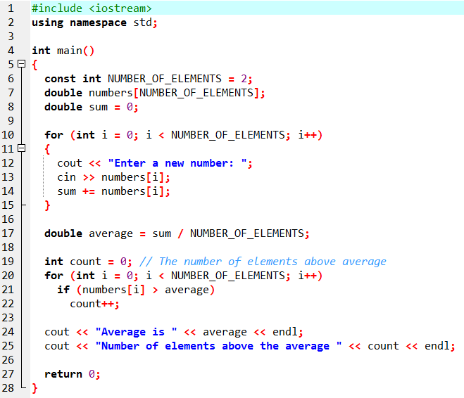
TUIT
Introduction
numbers
array
numbers[0]:
numbers[1]:
numbers[2]:
.
numbers[i]:
.
.
numbers[97]:
numbers[98]:
numbers[99]:

Slide 5
TUIT
Array Basics
An array is used to store multiple values of the same type. An element in an array can be accessed using an index.
An array is used to store a collection of data, but often it is more useful to think of an array as a collection of variables of the same type. Instead of declaring individual variables, such as number0, number1, …, and number99, you declare one array with a name such as numbers and use numbers[0], numbers[1],…, and numbers[99] to represent individual variables. This section introduces how to declare arrays and access array elements using indexes.

Slide 6
TUIT
Declaring Arrays
To declare an array, you need to specify its element type and size using the following syntax:
elementType arrayName[SIZE];
The elementType can be any data type, and all elements in the array will have the same data type. The SIZE, known as array size declaratory, must be an expression that evaluates to a constant integer greater than zero. For example, the following statement declares an array of 10 double elements:
arrayName[index] = value;

Slide 7
TUIT
Declaring Arrays
For example, the following code initializes the array:
double myList[10];
myList[0] = 5.6;
myList[1] = 4.5;
myList[2] = 3.3;
myList[3] = 13.2;
myList[4] = 4.0;
myList[5] = 34.33;
myList[6] = 34.0;
myList[7] = 45.45;
myList[8] = 99.993;
myList[9] = 111.23;
myList[0]
5.6
myList[1]
5.6
myList[2]
5.6
myList[3]
5.6
myList[4]
5.6
myList[5]
5.6
myList[6]
5.6
myList[7]
5.6
myList[8]
5.6
myList[9]
5.6

Slide 8
TUIT
Note
The array size used to declare an array must be a constant expression in standard C++.
int size = 4;
double myList[size]; // Wrong
But it is all right if SIZE is a constant as follows:
const int SIZE = 4;
double myList[SIZE]; // Correct

Slide 9
TUIT
Tip
If array have the same element type, they can be declared together, as follows:
elementType arrayName[size1], arrayName2[size2],…, arrayNameN[sizeN];
The arrays are separated by commas. For example,
double list1[10], list2[25];

Slide 10
TUIT
Accessing Array Elements
The array elements are accessed through the integer index. Array indices are 0 – based; that is, they run from 0 to arraySize-1. The first element is assigned the index 0, the second element is assigned 1, and so on. Each element in the array is represented using the following syntax:
arrayName[index];
For example, myList[9] represented the last element in the array myList.
Fore example, the following code adds the values in myList[0] and myList[1] to myList[2]. myList[2] = myList[0] + myList[1];
The following code increments myList[0] by 1: myList[0]++;

Slide 11
TUIT
Accessing Array Elements
The following code invokes the max function to return the larger number between myLIst[1] and myLIst[2]:
cout << max(myList[1], myList[2]) << endl;
The following loop assigns 0 to myList[0], 1 to myList[1],…, and 9 to myList[9]:
for (int i = 0; i < 10; i++)
{
myList[i] = i;
}

Slide 12
TUIT
Caution
Accessing array elements using indexes beyond the boundaries (e.g., myList[-1] and myList[10]) causes an out-of-bounds error. Out of bounds is a serious error. Unfortunately, the C++ compiler does not report it. Be careful to ensure that array indexes are within bounds.

Slide 13
TUIT
Array Initializers
C++ has a shorthand notation, known as the array initializer, which declares and initializes an array in a single statement, using the following syntax:
elementType arrayName[arraySize] = {value0, value1, … , valueN}
For example: double myList[4] = {1.9, 2.9, 3.4, 3.5}
This statement declares and initializes the array myList with four elements, making it equivalent to the statements shown below:
double myList[4];
myList[0] = 1.9;
myList[1] = 2.9;
myList[2] = 3.4;
myList[3] = 3.5;

Slide 14
TUIT
Caution
Using an array initializer, you must declare and initialize the array in one statement. Splitting it would cause a syntax error. Thus, the next statement is wrong:
double myList[4];
myList = {1.9, 2.9, 3.4, 3.5};

Slide 15
TUIT
Note
C++ allows you to omit the array size when declaring and creating an array using an initializer. For example, the following declaration is fine:
double myList[] = {1.9, 2.9, 3.4, 3.5};
The compiler automatically figures out how many elements are in the array.
C++ allows you to initialize a part of the array. For example, the following statement assigns values 1.9, 2.9 to the first two elements of the array. The other two elements will be set to zero.
double myList[4] = {1.9, 2.9};
Note that if an array declared, but not initialized, all its elements will contain “garbage” like other local variables.

Slide 16
TUIT
Processing Arrays
When processing array elements, you will often use a for loop – for the following reasons:
All of the elements in an array are of the same type. They are evenly processed in the same way using a loop.
Since the size of the array is known, it is natural to use a for loop.
Assume the array is declared ass follows:
const int ARRAY_SIZE = 10;
double mmyList[ARRAY_SIZE];

Slide 17
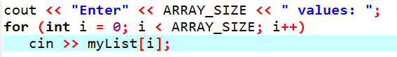
TUIT
Processing Arrays
Initialing arrays with input values: The following loop initializes the array myList with user input values:

Slide 18
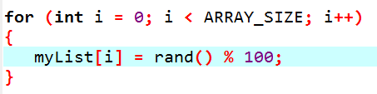
TUIT
Processing Arrays
Initialing arrays with random values: The following loop initializes the array myList with random values between 0 and 99:

Slide 19
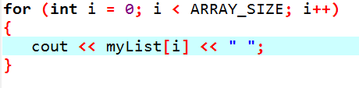
TUIT
Processing Arrays
Printing arrays: To print an array, you must print each element in it, using a loop like the following:

Slide 20

TUIT
Processing Arrays
Copying arrays: Suppose you have two arrays, list and myList. Can you copy myList to list using a syntax like the following?
list = myList;
This is not allowed in C++. You must copy individual elements from one array to the other as follows:

Slide 21
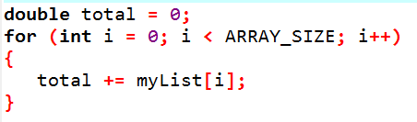
TUIT
Processing Arrays
Summing all elements: Use a variable named total to store the sum. Initially, total is 0. Add each element is the array to total using a loop like this:

Slide 22
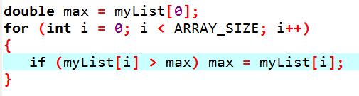
TUIT
Processing Arrays
Finding the largest element: Use a variable named max to store the largest element. Initially, max is myList[0]. To find the largest element in the array myList, compare each element in it with max, and then update max if the element is greater than max.

Slide 23
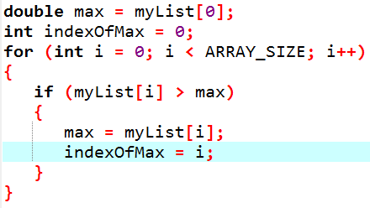
TUIT
Processing Arrays
Finding the smallest index of the largest element: Often you need to locate the largest element in an array. If an array has multiple elements with the same largest value, find the smallest index of such an element. Suppose the array myList is {1, 5, 3, 4, 5, 5}.

Slide 24
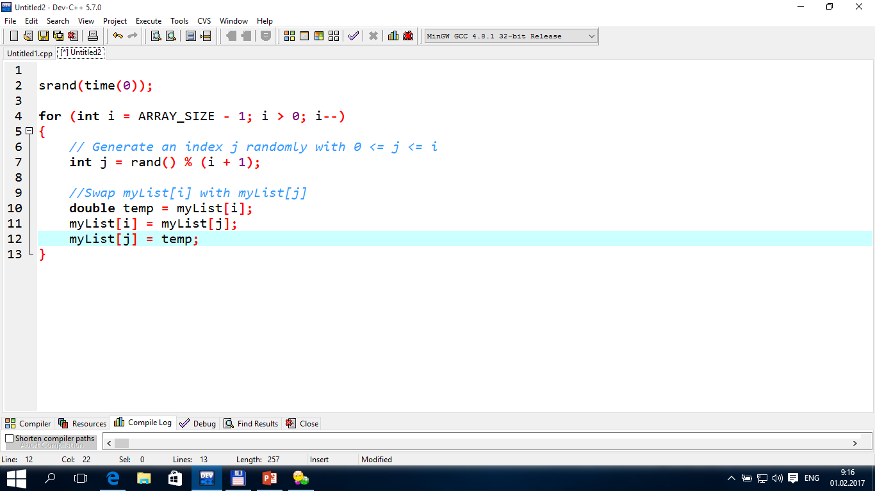
TUIT
Processing Arrays
Random Shuffling: In many applications, you need to reorder the elements in an array randomly. This is called shuffling. To accomplish this, for each element myList[i], randomly generate an index j and swap myList[i] with myList[j], as follows:

Slide 25
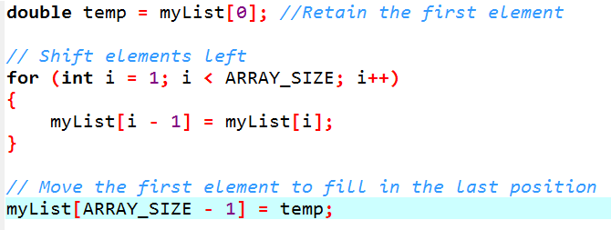
TUIT
Processing Arrays
Shifting elements: Sometimes you need to shift the elements one position to the left and fill the last element with the first element:

Slide 26
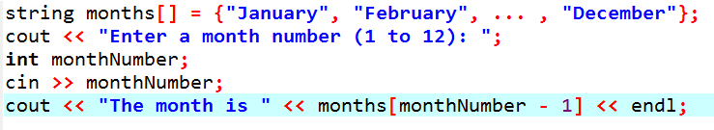
TUIT
Processing Arrays
Simplifying coding: Arrays can be used to simplify coding for certain tasks. For example. Suppose you want to obtain the English name of a given month by its number. If the month names are stored in an array, the month name for a given month can be accessed simply via the index. The following code prompts the user to enter a month number and displays its month name:

Slide 27
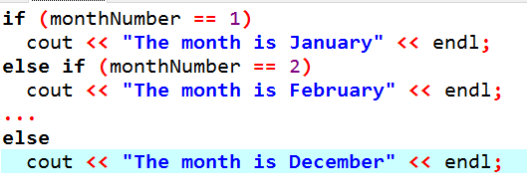
TUIT
Processing Arrays
If you didn’t use the months array, you would have to determine the month name using a lengthy multiway if – else statement as follows:

Slide 28
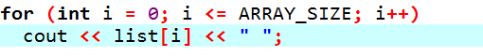
TUIT
Caution
Programmers often mistakenly reference the first element in an array with index 1. This is called the off-by-one error. It is a common error in a loop to use <= where < should be used. For example, the following loop is wrong:
The <= should be replaced by <.

Slide 29
TUIT
Tip
Since C++ does not check the array’s bound, you should pay special attention to ensure that the indexes are within the range. Check the first and the last iteration in a loop to see whether the indexes are in the permitted range.

Slide 30
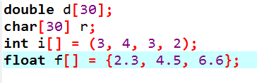
TUIT
Check Point
Which of the following statements are valid array declarations?

Slide 31
TUIT
Check Point
Write C++ statements to do the following:
Declare an array to hold 10 double values.
Assign value 5.5 to the last element in the array.
Display the sum of the first two elements.
Write a loop that computes the sum of all elements in the array.
Write a loop that finds the minimum element in the array.
Randomly generate an index and display the element at this index in the array.
Use an array initializer to declare another array with initial values 3.5, 5.5, 4.52, and 5.6

Slide 32
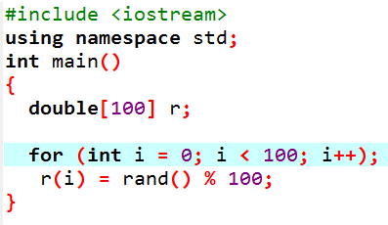
TUIT
Check Point
Identify and fix the errors in the following code:

Slide 33
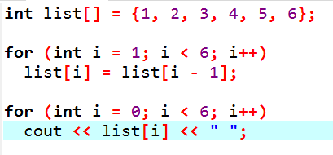
TUIT
Check Point
What is the output of the following code?

Slide 34
TUIT
Problem: Lotto Numbers
The problem is to write a program that checks if all the input numbers cover 1 to 99.
Each Pick – 10 lotto ticket has 10 unique numbers ranging from 1 to 99. Suppose you buy a lot of tickets and would like to have them cover all numbers from 1 to 99. Write a program that reads the ticket numbers from a file and checks whether all numbers are covered. Assume the last number in the file is 0. Suppose the file contains the numbers
80 3 87 62 30 90 10 21 46 27
12 40 83 9 39 88 95 59 20 37
80 40 87 67 31 90 11 24 56 77
11 48 51 42 8 74 1 41 36 53
52 82 16 72 19 70 44 56 29 33
54 64 99 14 23 22 94 79 55 2
60 86 34 4 31 63 84 89 7 78
43 93 97 45 25 38 28 26 85 49
47 65 57 67 73 69 32 71 24 66
92 98 96 77 6 75 17 61 58 13
35 81 18 15 5 68 91 50 76
0
You program should display
The tickets cover all numbers

Slide 35
TUIT
Problem: Lotto Numbers
Suppose the file contains the numbers
11 48 51 42 8 74 1 41 36 53
52 82 16 72 19 70 44 56 29 33
0
Your program should display
The tickets don’t cover all numbers

Slide 36
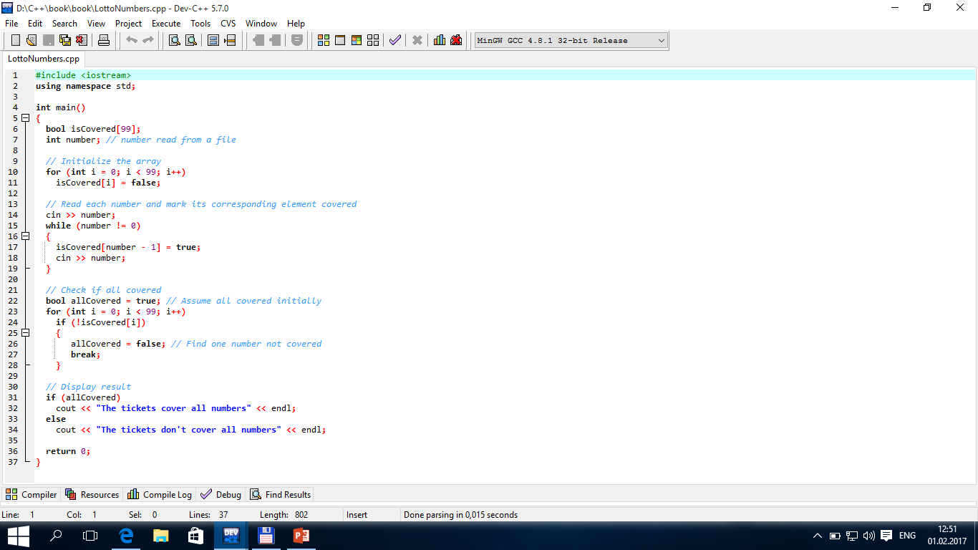
TUIT
Problem: Lotto Numbers
Suppose you have created a text file named LottoNumbers.txt that contains the input data 2 5 6 5 4 3 23 43 2 0. You can run the program using the following command:
g++ LottoNumbers.cpp –o LottoNumbers.exe
LottoNumbers.exe < LottoNumbers.txt

Slide 37
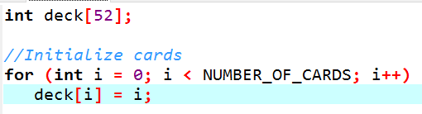
TUIT
Problem: Deck of Cards
The problem is to create a program that will randomly select four cards from a deck of 52 cards.
All the cards can be represented using an array named deck, filled with initial values 0 to 51, as follows:

Slide 38
TUIT
Problem: Deck of Cards
Card numbers 0 to 12, 13 to 25, 26 to 38, 39 to 51 represent 13 spades, 13 hearts, 13 diamonds, and 13 clubs, respectively. cardNumber / 13 determines the suit of the card and cardNumber % 13 determines the rank of the card. After shuffling the array deck, pick the first four cards from deck.

Slide 39

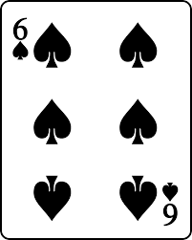
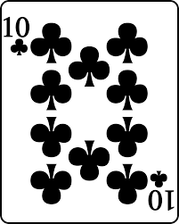
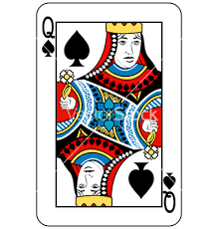
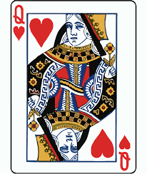
TUIT
Problem: Deck of Cards
deck
deck
0
.
.
.
12
13
.
.
.
25
26
.
.
.
38
39
.
.
.
51
Card number 6 is the
7 (6 % 13 = 6) of Spades (6 / 13 =0)
[0]
.
.
.
[12]
[13]
.
.
.
[25]
[26]
.
.
.
[38]
[39]
.
.
.
[51]
0
.
.
.
12
13
.
.
.
25
26
.
.
.
38
39
.
.
.
51
[0]
[1]
[2]
[3]
[4]
[5]
.
.
.
[25]
[26]
.
.
.
[38]
[39]
.
.
.
[51]
6
48
11
24
.
.
.
.
.
.
.
.
.
.
.
.
.
.
.
.
13 Spades
Card number 48 is the
10 (48 % 13 = 9) of Spades (48 / 13 =3)
Card number 11 is the
Queen (11 % 13 = 11) of Spades (11 / 13 =0)
13 Hearts
Card number 24 is the
Queen (24 % 13 = 11) of Hearts (24 / 13 =1)
13 Diamonds
13 Clubs

Slide 40
TUIT
Problem: Deck of Cards
0
1
.
.
.
10
11
12
Ace
0
1
2
3
Spades
2
Hearts
cardNumber / 13 =
cardNumber % 13 =
Diamonds
Jack
Queen
Clubs
King

Slide 41
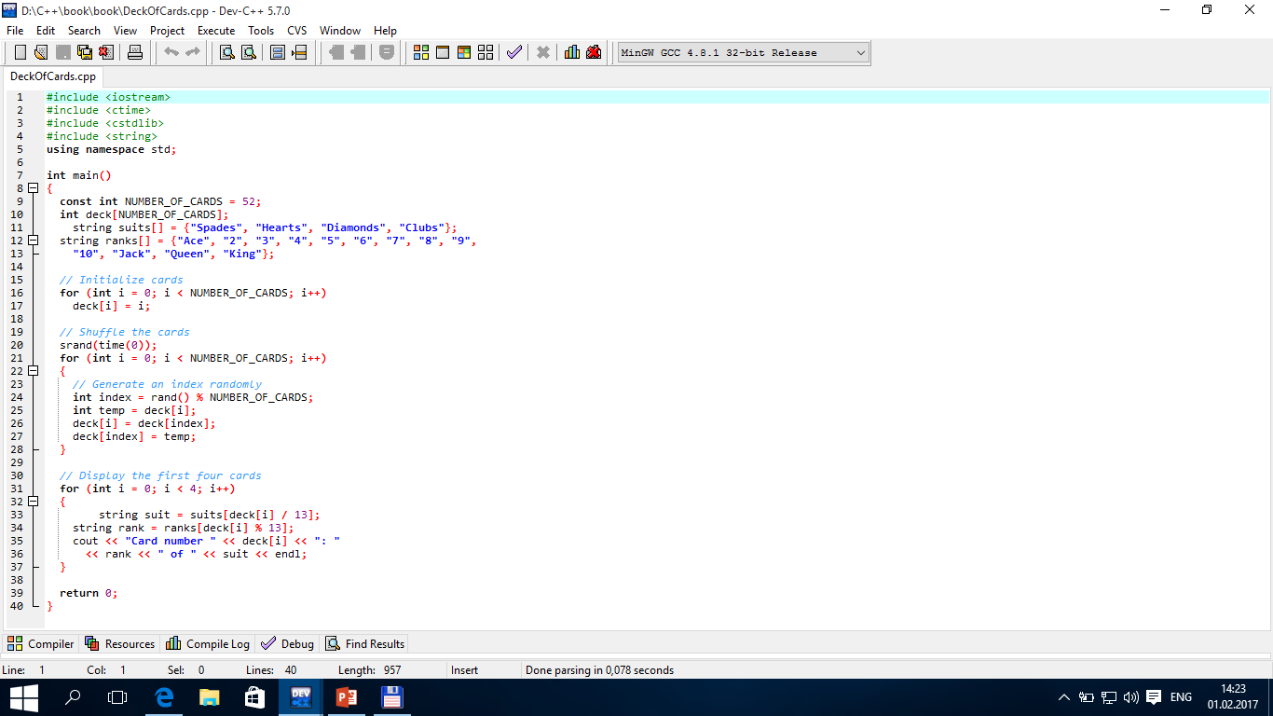

TUIT
Problem: Deck of Cards
Card number 39: Ace of Clubs Card number 33: 8 of Diamonds Card number 16: 4 of Hearts Card number 6: 7 of Spades

Slide 42
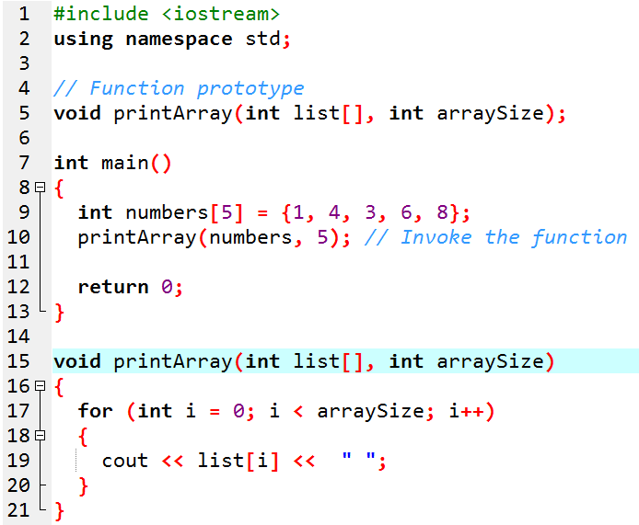
TUIT
Passing Arrays to Functions
When an array argument is passed to a function , its starting address is passed the array parameter in the function. Both parameter and argument refer to the same array. Just as you can pass single values to a function, you also can pass an entire array to a function.
1 4 3 6 8

Slide 43
TUIT
Passing Arrays to Functions
In the function header (line 14), int list[] specifies that the parameter is an integer array of any size. Therefore, you can pass any integer array to invoke this function (line 9). Note that the parameter names in function prototypes can be omitted. So, the function prototype may be declared without the parameter names list and arraySize as follows:
void printArray(int [], int); // Function prototype

Slide 44
TUIT
Note
Normally when you pass an array to a function, you should also pass its size in another argument, so that the function knows how many elements are in the array. Otherwise, you will have to hard code this into the function or declare it in a global variable. Neither is flexible or robust.

Slide 45
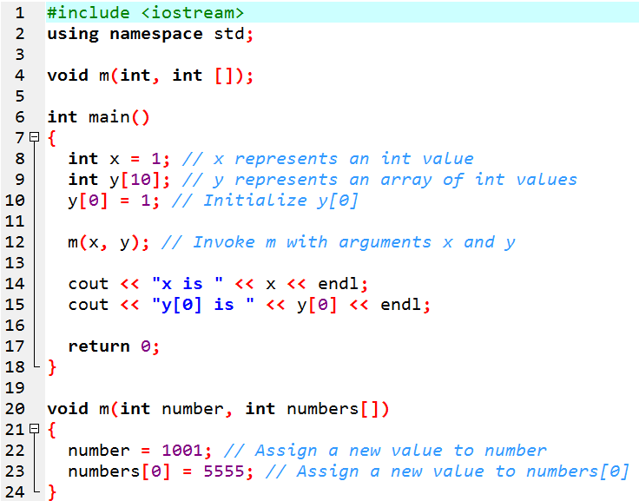
TUIT
Example
x is 1 y[0] is 5555

Slide 46
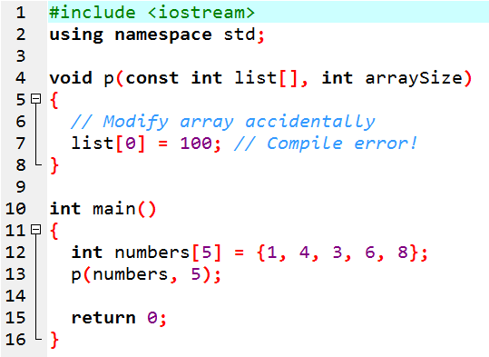
TUIT
Preventing Changes of Array Arguments
You can define const array parameter in a function to prevent it from being changed in a function.
ConstArrayDeom.cpp:7 error: assignment of read-only location

Slide 47
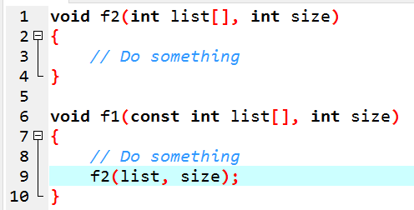
TUIT
Note
If you define a const parameter in a function f1 and this parameter is passed to another function f2, then the corresponding parameter in function f2 must be declared const for consistency. Consider the following code:
The compiler reports an error, because list is const in f1 and it is passed to f2, but it is passed to f2, but it is not const in f2. The function declaration for f2 should be
void f2(const int list[], int size)

Slide 48
TUIT
Summary
An array stores a lsit of value of the same type.
An array is declared using the syntax elementType arrayName[size]
Each element in the array is represented using the syntax arrayName[index]
An index must be an integer or an integer expression.
Array index is 0-based, meaning that the index for the first element is 0.
Programmers often mistakenly reference that first element in an array with index 1 rather than 0. This causes the index of-by-one error.
Accessing array elements using indexes beyond the boundaries causes out-of-bounds error.
Out of bounds is a serious error, but it is not checked automatically by the C++ compiler.
C++ has a shorthand notation, known as the array initializer, which declares and initializes an array in a single statement using the sytax:
elementType arrayName[] = {value0, value1,…, valuek};

